Slide 1
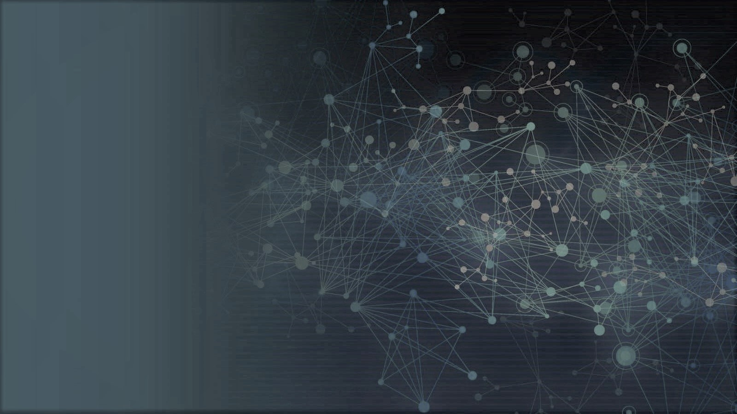
Introduction to Data Analysis
Assignment 4
Assignment 4
Assignment 4
2
+
2
+
Introduction to Data Analysis
Assignment 5
Clustering
Assignment 4
Name: Kartik Sojitra
(100723768)
Name: Kartik Sojitra
(100723768)

Slide 2

TABLE OF CONTENTS
2
+
2
+
Introduction
Description Of Analysis Conducted
Summary of Analysis
Identify the requirement of clusters
Comparison of SVM Algorithm Vs Clustering Algorithm
Explanation of how the clustering analysis can help

Slide 3
Presentation Title Alt 2
2
+
2
+
Introduction
Mr. John Hughes has been analyzing patient data for illness study.
To analyze the data, we are using the Support Vector Machine (SVM) and Clustering Algorithm.
Support Vector Machine (SVM) is best to separate the two hyperplanes and K means is an iterative clustering algorithm that aims to find local maxima in each iteration.
The objective is to import the illnessstudy.csv dataset and run SVM and K mean algorithm in Jupyter notebook.
SUBTITLE GOES HERE

Slide 4
2
+
2
+
Description Of Analysis
SVM algorithm is Support Vector Machine (SVM) which is based on categorical variables.
SVM Model can create a high accuracy for the model and it is a powerful and flexible class of supervised algorithms for both classification and regression..
The purpose of SVM is to separate the given dataset into the best possible way and determine the distance between either nearest points that is known as the margin.
K Means clustering requires prior knowledge of K i.e. no. of clusters you want to divide your data into.
Continue…

Slide 5
2
+
2
+
K Means is found to work well when the shape of the clusters is hyper spherical.
The time complexity of K Means is linear.
Clustering is an unsupervised machine learning approach, but can it be used to improve the accuracy of supervised machine learning algorithms as well by clustering the data points into similar groups

Slide 6
2
+
2
+
Summary Of Analysis
Load libraries
Load data - illnessstudy.csv
#Set x and y variable
#Determine optimum number of clusters
#Create silhouette coefficients
#Apply K means clustering
#Add prediction column to dataset
Evaluate the algorithm
Plot of clusters
Create K mean with 2 clusters
Plot of clusters

Slide 7
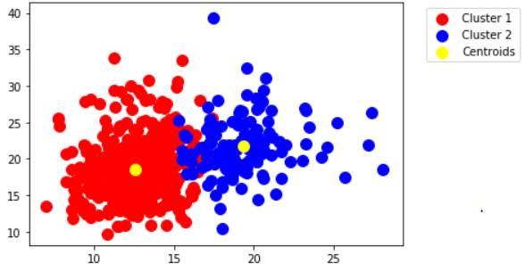
Identify the requirement of clusters
SVM
2
NBNNB
+
2
+
There are two clusters reveals from illnessstudy dataset after running the script in pandas.
There are several methods of executing clustering and It uses for unsupervised learning in many domains.
The main benefit of clustering over-classification is that it is flexible to changes and helps single out beneficial features that distinguish different groups in our data set.
We can increase the accuracy of a supervised machine learning algorithm using clustering.

Slide 8
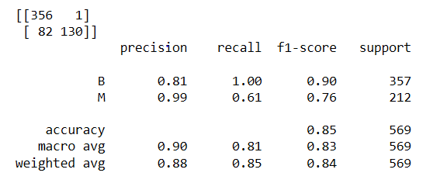
Comparison of SVM Algorithm Vs Clustering Algorithm
2
+
2
+
To evaluate an algorithm, we used a confusion matrix, precision and recall, besides, confusion matrix and classification methods are used to find the scores. Accuracy of this model is 0.85 which demonstrates that SVM model is very good to predict results.
There are two groups shown in figure after clustering and there are two centroid points in both groups. we first partition the set of data into combinations based on data similarity and then assign the labels to the groups.

Slide 9
Explanation of how the clustering analysis can help
2
+
2
+
Algorithms should be intelligent to be applied to any kind of data such as interval-based (statistical) data, categorical, and binary data.
The clustering algorithm should be capable of discovering clusters of random shapes.
They should not be bounded to only distance measures that tend to find a spherical cluster of little quantities.
We need extremely scalable clustering algorithms to deal with large databases and collections of centers can be identified depending on the goal attributes.
Mr. John Hughes should not add any variable or make any change because both models are very good..

Slide 10
Thank
2
+
Thank You..

